Slide 1



MEET
AVRIO ADVOCATI
AN INTERNATIONAL NETWORK OF LAW FIRMS

Slide 2
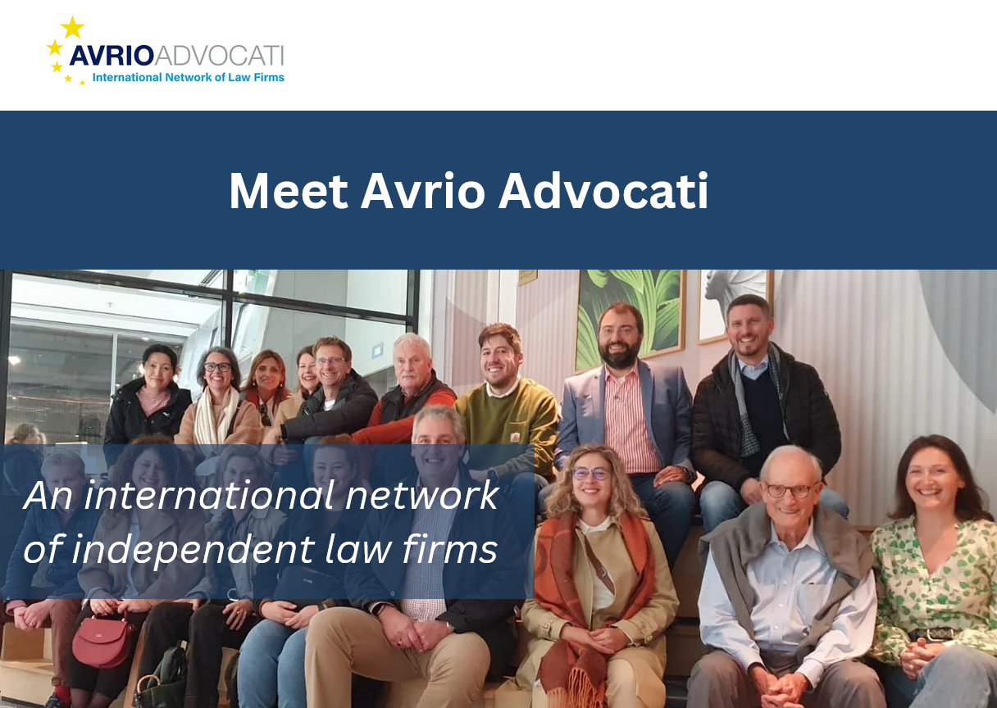
Option 2 – opening slide (used for warm target)
MEET
AVRIO ADVOCATI
AN INTERNATIONAL NETWORK OF LAW FIRMS

Slide 3



Founded in 1986
01
02
To create a strong alliance of independent legal professionals
About Us
03
Developed into a network spanning multiple continents
04
Committed to cross-border collaboration and legal expertise
05
Knowledge share and best practice

Slide 4


International
Over 30 members located across 30 countries and 72 offices /cities around the world
Legal Experts
Hundreds of lawyers working together to support international clients
Collaboration
About
Our
Members
Committed to cross-border collaboration and legal expertise
Legal Areas
Specialists in corporate law, dispute resolution, IP, employment law, real estate, family and more

Slide 5


Member Locations
Europe, US, Canada, Asia, and Africa

Slide 6

Member Benefits
PEOPLE
QUALITY
  Members are leaders in their chosen fields
  High quality work referrals
  Trusted network of peers who are highly skilled
  Peer learning
Q
P
I
O
OPPORTUNITIES
INTERNATIONAL
  Legal support globally
  Trends and their impact on legal services
  Grow your firm Receive referrals
  Take part in the lawyer exchange programme
An International Network of Law Firms

Slide 7




Conferences & Networking
  2 international conferences each year
  8 specialist working groups - meet online monthly / quarterly
  Webinars on emerging legal trends and international regulations

Slide 8

We are growing
The Avrio Advocati Expansion Committee are on the look out for suitable law firms to join our network so that you have more firms to network with, learn from and refer work to.

Slide 9
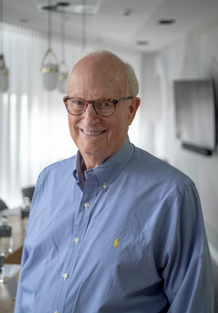

Avrio Advocati Chair
Avrio is an extensive network of international, collaborative firms that share knowledge and work in concert to serve the needs of clients worldwide.
About Avrio Advocati
Bruce
Bowden
LEECH TISHMAN

Slide 10


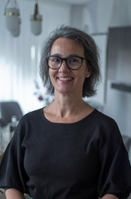
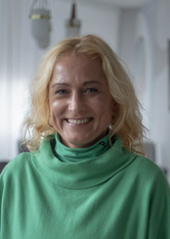

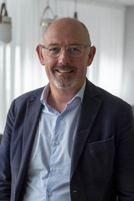
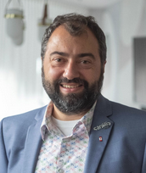
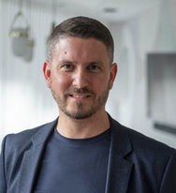
Meet Our Board
Bruce Bowden
Ana RitaRelógio
Vesna Gorjup
Bryan Bletso
LEECH TISHMAN
CSA
GORUP LAW
IRWIN MITCHELL
Philip Gilliland
Christian Sarailis
Benoît Morzier
CALDWELL & ROBINSON
SARAILIS AVOCATS
AVOPARTNER

Slide 11




Contact Us
@avrioadvocati
info@avrioadvocati.com
www.avrioadvocati.com

Slide 12

THANK YOU
12/02/2025

